Slide 1
Final Exam

Slide 2
Review

Slide 3
What did we learn?
Shneiderman mantra
Visual encoding
Biases
Visualization tools

Slide 4
Visual Information-Seeking Mantra
"Overview first, zoom and filter, then details on demand.”
- Ben Shneiderman
Overview
Zoom and filter
Details on demand
Relate
History
Extract
Notes:
Visual Information-Seeking Mantra: Excellent framework for designing information visualization.
Relate - E.g. click on a medication and see related visit report, prescription, and lab test.
History - Undo, replay, etc.
Extract – Extract and save the subset

Slide 5
Visual encoding
How data is mapped to visual elements
Notes:
You have data. How do we turn them into a visualization? In fact, why do we even want to visualize data? Helps humans understand and analyze the data. And it should clearly and efficiently communicate the information.
Visual encoding deals with things like which shape, size, and color to use.
Image source:

Slide 6
Visual encoding
Understand your data
Understand your audience
Understand your purpose
Notes:
Is your data: Quantitative? Ordinal? Nominal?

Slide 7
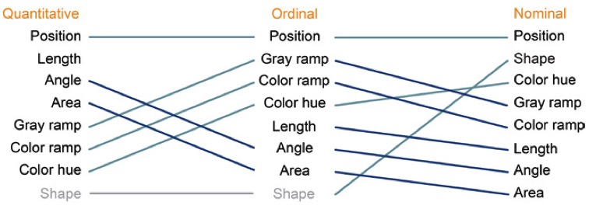
Visual encoding
Best practice
More accurate
Less accurate
Notes:
Turns out different people have different thoughts on this based on theories, experiences, and research.
Here is Mackinlay’s thoughts on visual encoding.
Source: Mackinlay. Automating the design of graphical presentations of relational information. Acm Transactions On Graphics. 1986;5(2):110-141.

Slide 8
Biases in visualization
“A systematic distortion of a statistical result due to a factor not allowed for in its derivation.”

Slide 9
Biases in visualization

Slide 10
Biases in visualization

Slide 11
Biases in visualization
Data
Visual representation
Annotation
Interactivity

Slide 12
Biases in visualization
Notes:
Source: http://www.fastcodesign.com/3024273/infographic-of-the-day/infographics-lie-heres-how-to-spot-the-bs

Slide 13
Biases in visualization
Notes:
Source: http://www.fastcodesign.com/3024273/infographic-of-the-day/infographics-lie-heres-how-to-spot-the-bs

Slide 14
Biases in visualization
Is this accurate?
Is this unfair?
Were the design choices made for a good reason?

Slide 15
Visualization tools

Slide 16
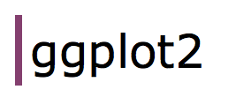
Visualization tools

Slide 17
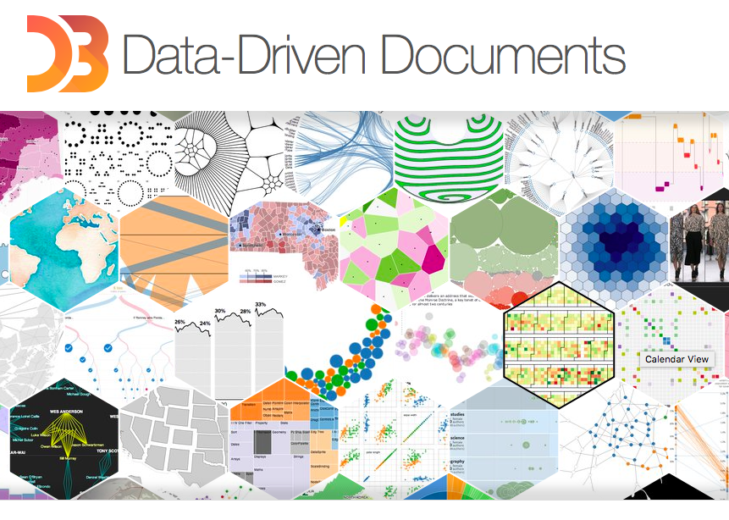
Visualization tools

